Slide 1
VIRAL REPLICATION
{بِسْمِ اللَّهِ الرَّحْمَنِ الرَّحِيمِ}

Slide 2
Lesson plan
1- Introduction
2- Steps of viral replication
A- Early steps (Attachment, entry, uncoating)
B- Viral replication
C- Late step (Assembly and release)

Slide 3
Introduction
To multiply, viruses must infect living cells
(obligate intracellular parasites)
Viral replication is a complex process during which the virus hijacks the cellular machinery to its own advantage.
To develop antiviral treatments, it is crucial to understand the steps of viral replication.

Slide 4
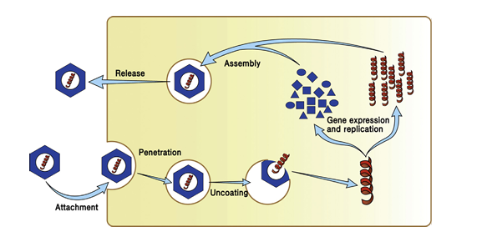
2- Steps of viral replication (life cycle of virus)
1- Attachement
2- Entry (Penetration)
6
Genom replication
Protein synthesis
5
3- Uncoating
(Decapsidation)
4- Replication
2
4
5- Assembly
(maturation)
1
6- Release
3

Slide 5
Early steps
Replication
Late steps
Gene expression
Assembly
Attachement
Release
Entry (Penetration)
Synthesis of viral proteins
Uncoating

Slide 6
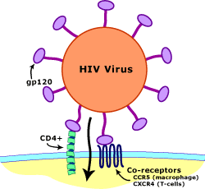
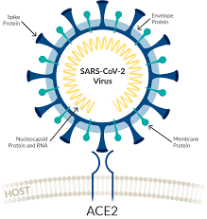
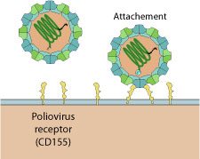
1-Attachement
Structural affinity between viral molecules and host cell receptors

Slide 7
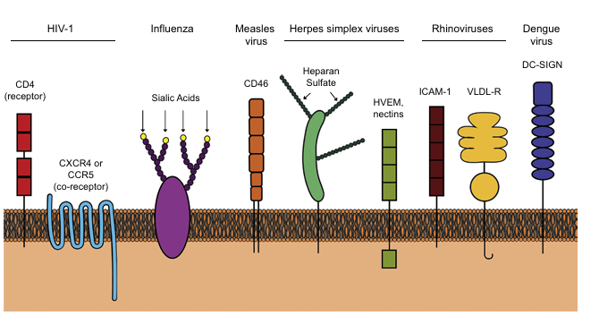
Structural affinity between viral molecules and host cell receptors
Receptor of VLDL
Cell-cell interaction
Immune modulation
Cell adhesion
Stimulation of immune system
Cell adhesion

Slide 8
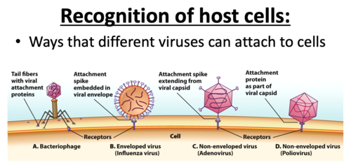
1-Attachement
Tail fiber proteins
GP of envelope (Spike)
Proteins of capsid (Spike)
Proteins as part of capsid

Slide 9
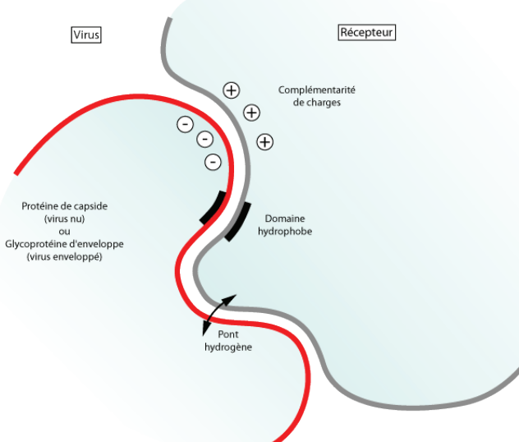
1-Attachement
Virus
H. C. Receptor
Charge Complentarity
Capsid protein or envelope GP
Hydrophobic domaine
Hydrogen bond

Slide 10
2- Entry (Penetration)
Mechanisms of cell entry differ between enveloped and non-enveloped viruses.
Viruses enters the cell, most often by endocytosis for non-enveloped viruses and by fusion of membranes for enveloped viruses.

Slide 11
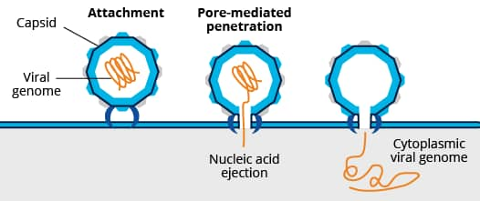
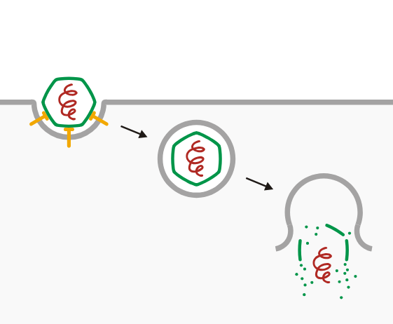
A. Entry pathways of naked (non-enveloped) viruses
Interaction capsid-memb
Endocytosis pathway
Attachment
V. genome
Cell host membrane
Capsid
Endosome
Cell host membrane
1
2
Uncoating
Poliovirus

Slide 12
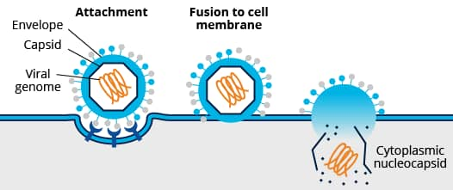
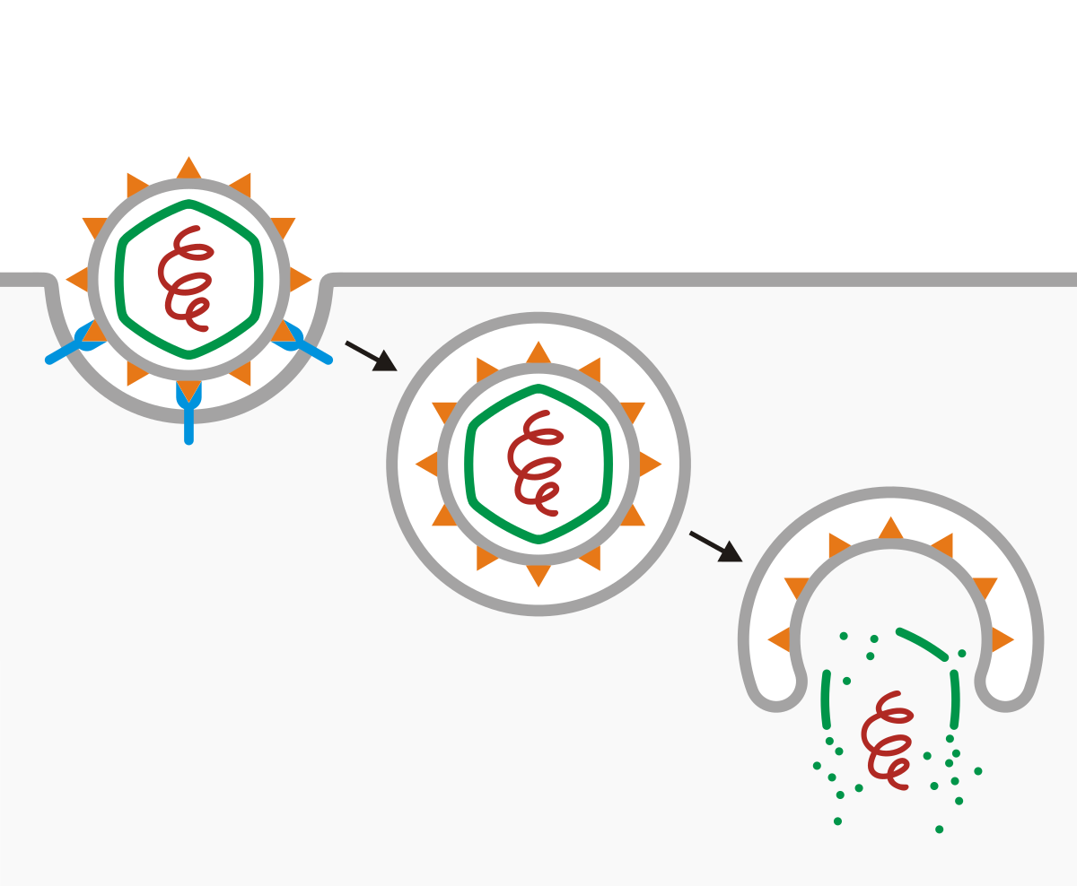
B. Entry pathways of enveloped viruses
Fusion pathway
Endocytosis pathway
Attachment
Endosome
1
2
Uncoating
HIV virus
Hepatitis C virus

Slide 13
3.Uncoating (Decapsidation)
Uncoating is the degradation of the viral capsid inside host cell.
In general, this step is carried out using cellular enzymes, but some viruses use their own uncoating enzymes.
Uncoating can occur in the cytoplasm or at the nuclear pores (DNA viruses).
It is either complete (for the majority of viruses) or partial (in some species).

Slide 14

3.Uncoating (Decapsidation)
Capsid degradation
N.A released in the cytoplasme

Slide 15
4- Replication
Production of new copies of the viral genome
Synthesis of all viral proteins (structural and functional)
The mode of replication depends on the nature of the
viral genome:
DNA virus
RNA virus :
Positive-strand RNA viruses (+ssRNA viruses)
Negative-strand RNA viruses (−ssRNA viruses)
Retroviruses (with reverse transcriptase)

Slide 16
A- Replication and Transcription of DNA Viruses
Nuclear localization, the viral genome must be transported into the nucleus
Transcription carried out by cellular enzymes (RNA polymerase)
Translation of RNA to proteins by cell ribosomes
Early phase Enzymes of replication (viral DNA and RNA polymerase)
Late phase structural proteins ( proteins of capsid and glycoproteins of envelope)

Slide 17
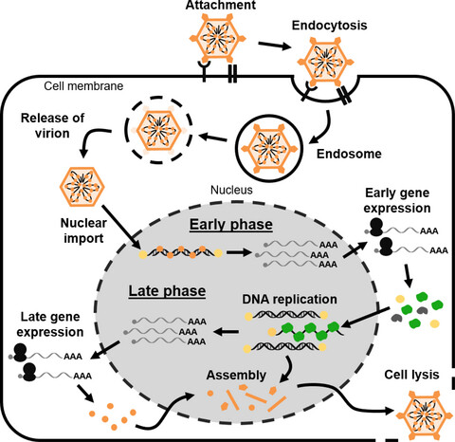
A- Replication and Transcription of DNA Viruses
DNA and RNA poly
Structural proteins

Slide 18
B- Replication and Transcription of RNA Viruses
3 types of RNA viruses:
Positive-strand RNA viruses (+ssRNA viruses)
Negative-strand RNA viruses (−ssRNA viruses)
Retroviruses (with reverse transcriptase) = RNA-dependent DNA polymerase

Slide 19
1. Positive-strand RNA viruses (+ssRNA viruses)
Cell ribosomes
Structural proteins (capsid and GP)
(+ssRNA)
= messenger RNA (mRNA)
viral enzymes
(RNA-dependent RNA polymerase (RdRp)
+RNA
- RNA
+RNA

Slide 20
2. Negative-strand RNA viruses (-ssRNA viruses)
Virus must bring with it RNA-dependent RNA polymerase (RdRp)
Replication
Translation
RdRp
Cell ribosomes
(-ssRNA)
(+ ssRNA)
= mRNA
Structural proteins (capsid and GP)
Viral enzymes (RdRp)
(-RNA)
(+RNA)
(-RNA)

Slide 21
3. Retroviruses (with reverse transcriptase) = RNA-dependent DNA polymerase
RdDp
R, transcriptase
RdDp
R, transcriptase
Integrase
Viral RNA
ssDNA
dsDNA
In cell DNA
Cell ribosomes
Cell RNA poly
translation
Viral proteins
RNAm

Slide 22
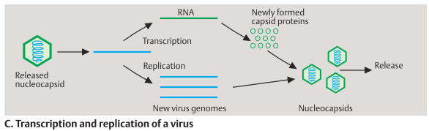
Replication of viral genom and formation on new virion

Slide 23
5- Assembly (Maturation )
During this step, newly synthesized genome (nucleic acid), and proteins are assembled to form new virus particles.
This may occur in the cell nucleus or in cell cytoplasm

Slide 24
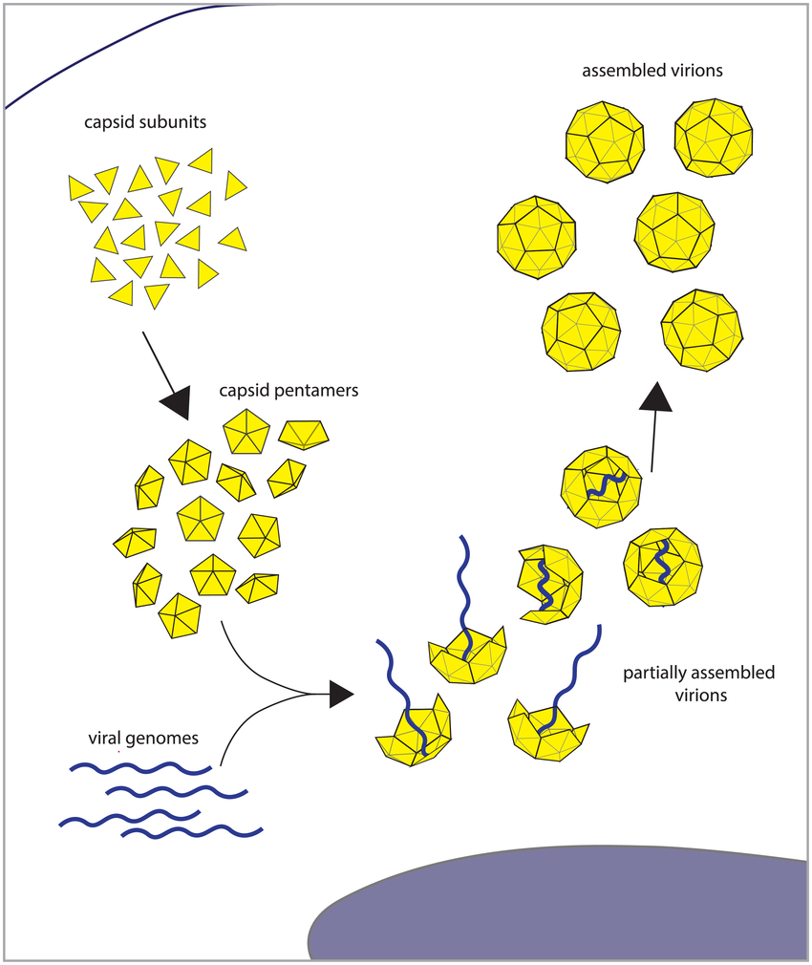
5- Assembly (Maturation )

Slide 25
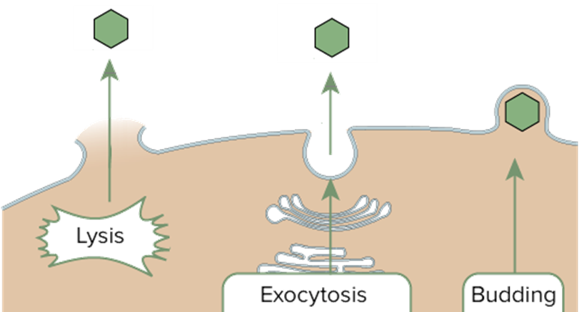
6- Release
The virus release from an infected cell occurs via budding, exocytosis, or cell lysis

Slide 26
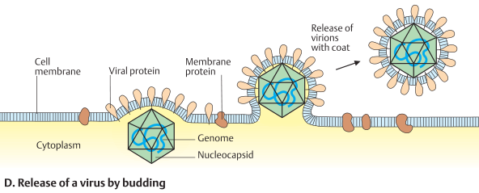
Release of virus by budding from host cell membrane
Example: HIV, influenza virus, and measles virus

Slide 27
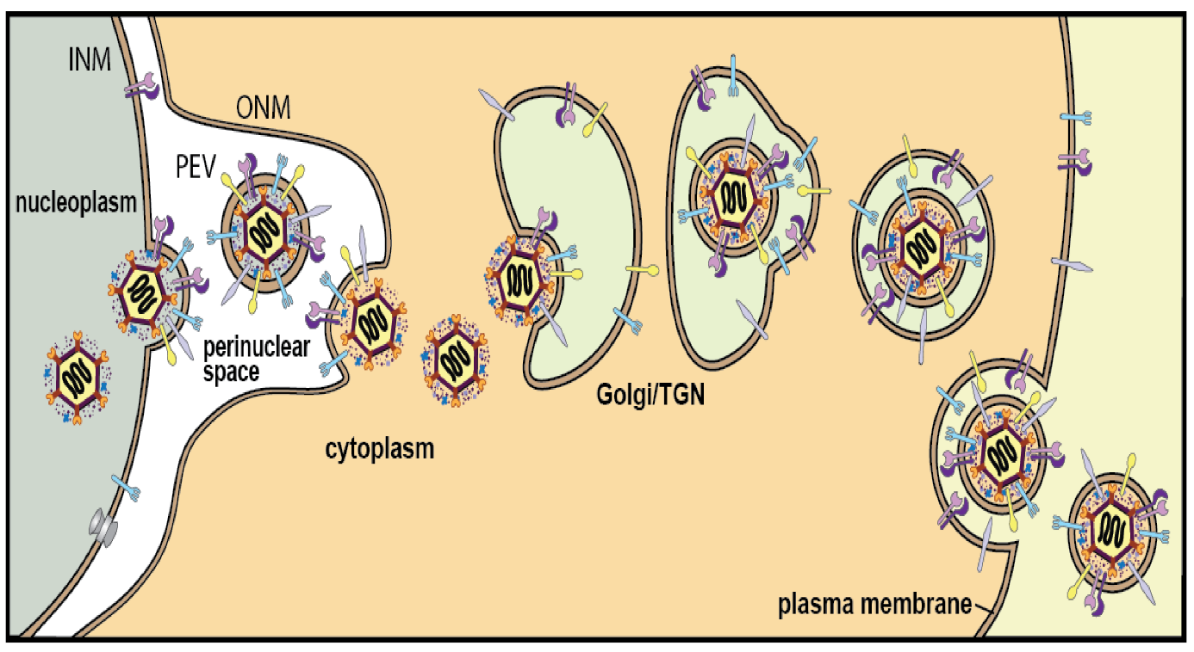
Release of virus by exocytosis from the host cell membrane
budding
budding
fusion
Exocytosis
Exocytosis
Herpesvirus

Slide 28
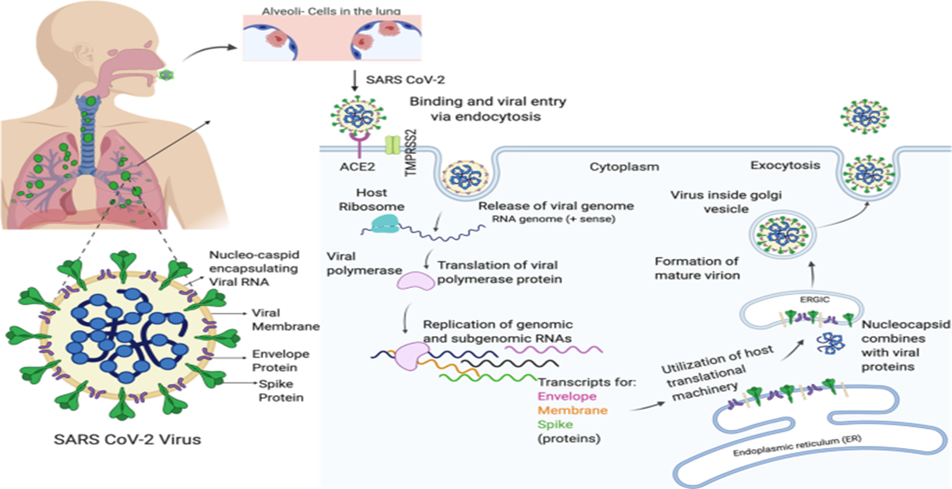
Release of virus by exocytosis from the host cell membrane.

Slide 29
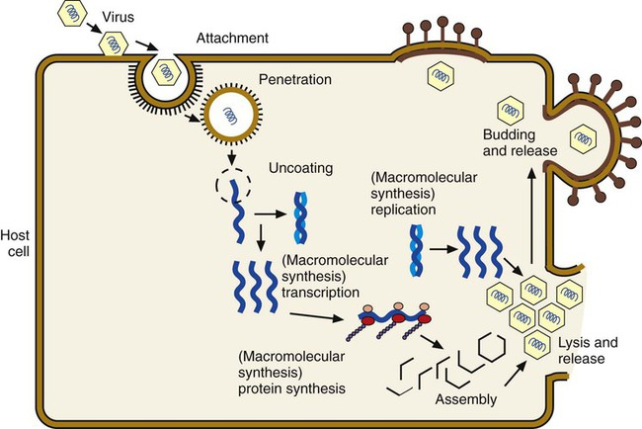

Slide 30
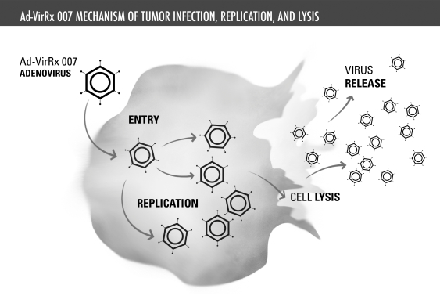
Virus release
Cell lysis
Cell membrane lysis and release of non-enveloped viruses. Exemple : Rotavirus

Slide 31
